Slide 1
p.M
Notes:
param_spring_damper = c(ks = 0.016, cs = 8, Fpert_BPA03 = 0, Fpert_BPA3 = 5,
Fpert_BPA30 = 10, Fpert_BPA300 = 20, Fpert_BPA100 = 13)

Slide 2
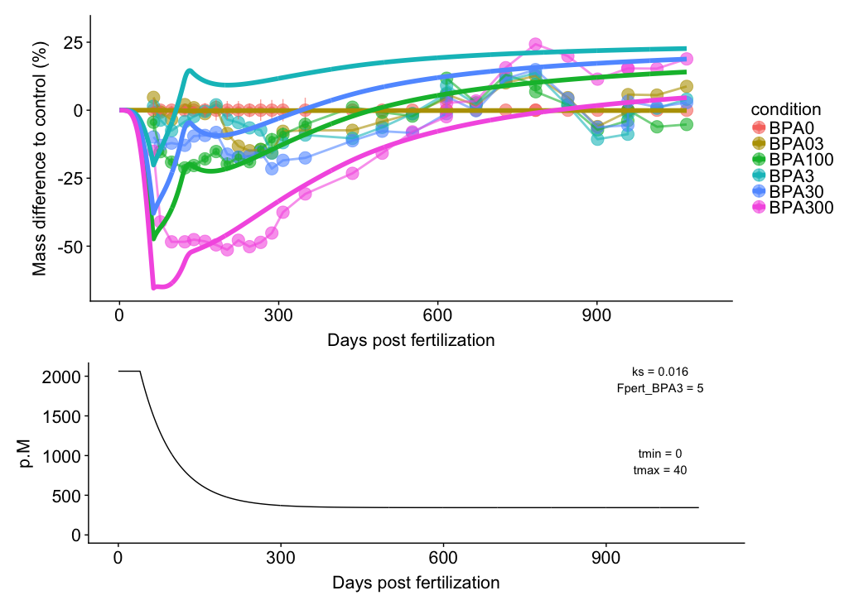
Notes:
param_spring_damper = c(ks = 0.016, cs = 8, Fpert_BPA03 = 0, Fpert_BPA3 = 5,
Fpert_BPA30 = 10, Fpert_BPA300 = 20, Fpert_BPA100 = 13)

Slide 3
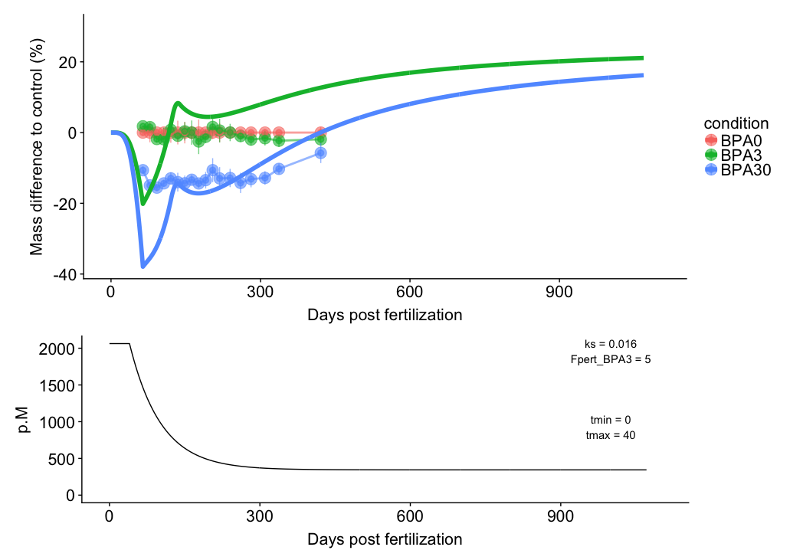
Notes:
param_spring_damper = c(ks = 0.016, cs = 8, Fpert_BPA03 = 0, Fpert_BPA3 = 5,
Fpert_BPA30 = 10, Fpert_BPA300 = 20, Fpert_BPA100 = 13)

Slide 4
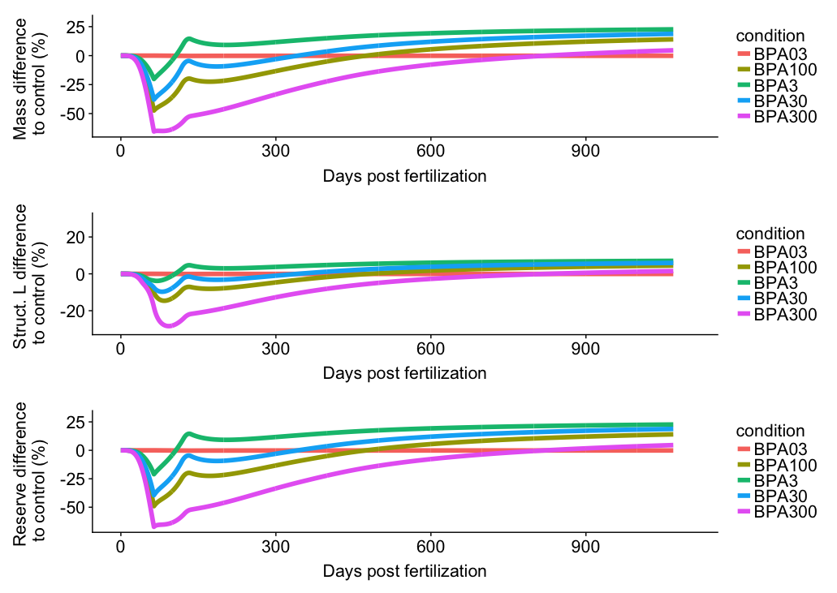
Notes:
param_spring_damper = c(ks = 0.016, cs = 8, Fpert_BPA03 = 0, Fpert_BPA3 = 5,
Fpert_BPA30 = 10, Fpert_BPA300 = 20, Fpert_BPA100 = 13)

Slide 5
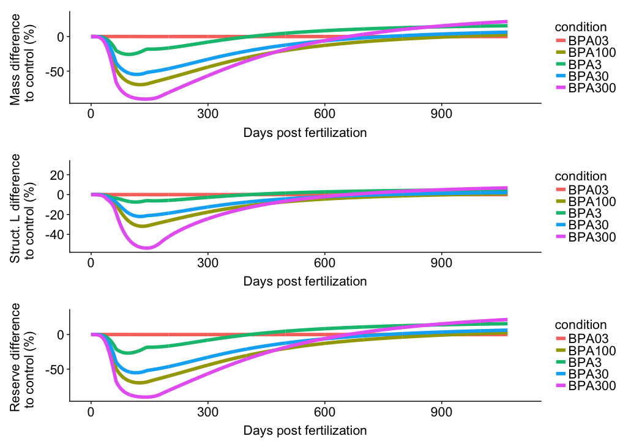
f = 0.3

Slide 6
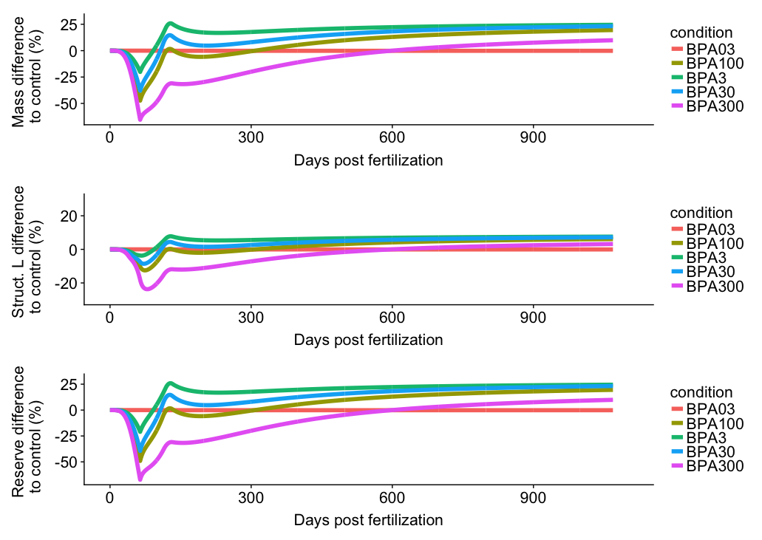
f = 1

Slide 7
E.G
Notes:
param_spring_damper = c(ks = 0.016, cs = 8, Fpert_BPA03 = 0, Fpert_BPA3 = 5,
Fpert_BPA30 = 10, Fpert_BPA300 = 20, Fpert_BPA100 = 13)

Slide 8
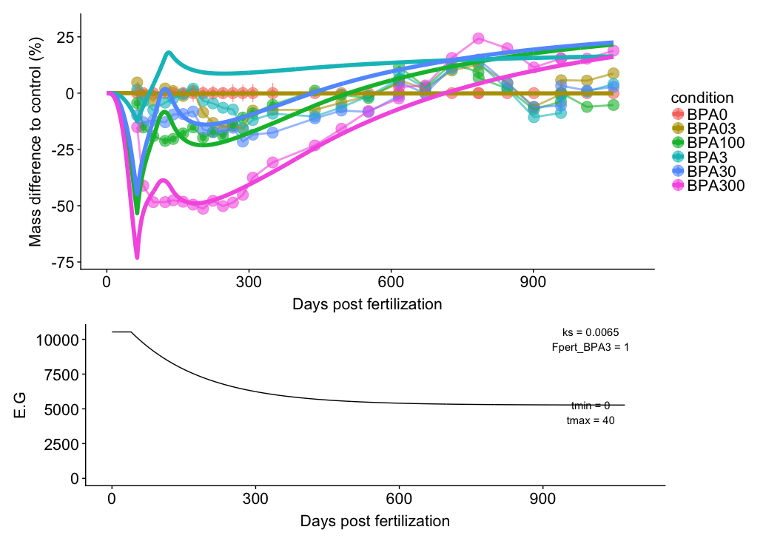
Notes:
param_spring_damper = c(ks = 0.0065, cs = 8, Fpert_BPA03 = 0, Fpert_BPA3 = 1,
Fpert_BPA30 = 4 , Fpert_BPA300 = 8.5, Fpert_BPA100 = 5)

Slide 9
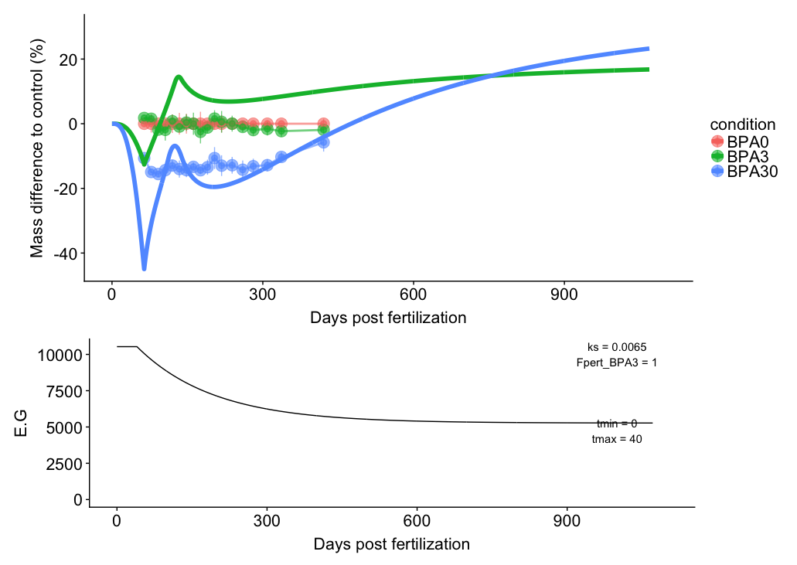
Notes:
param_spring_damper = c(ks = 0.0065, cs = 8, Fpert_BPA03 = 0, Fpert_BPA3 = 1,
Fpert_BPA30 = 4 , Fpert_BPA300 = 8.5, Fpert_BPA100 = 5)

Slide 10
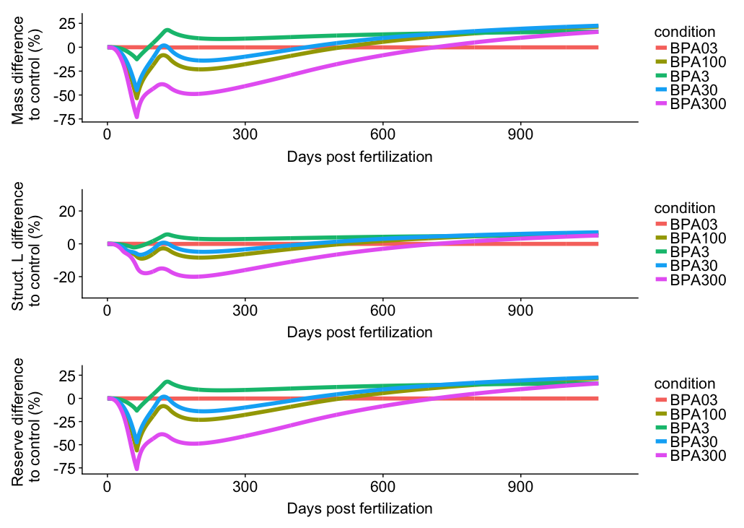
Notes:
param_spring_damper = c(ks = 0.0065, cs = 8, Fpert_BPA03 = 0, Fpert_BPA3 = 1,
Fpert_BPA30 = 4 , Fpert_BPA300 = 8.5, Fpert_BPA100 = 5)

Slide 11
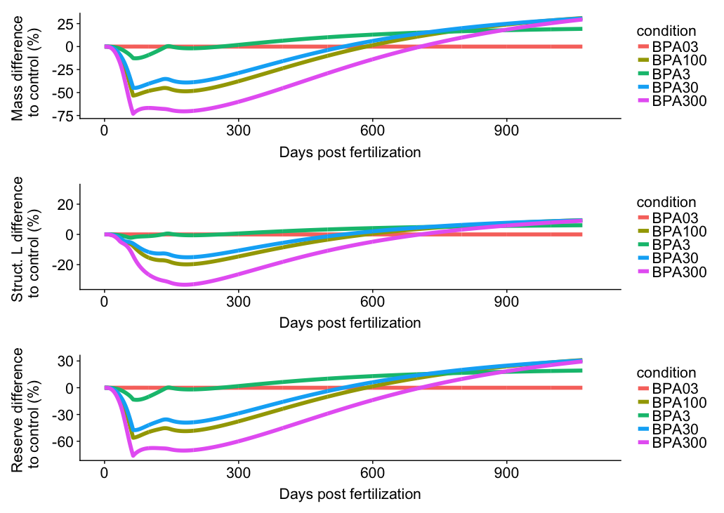
f = 0.3

Slide 12
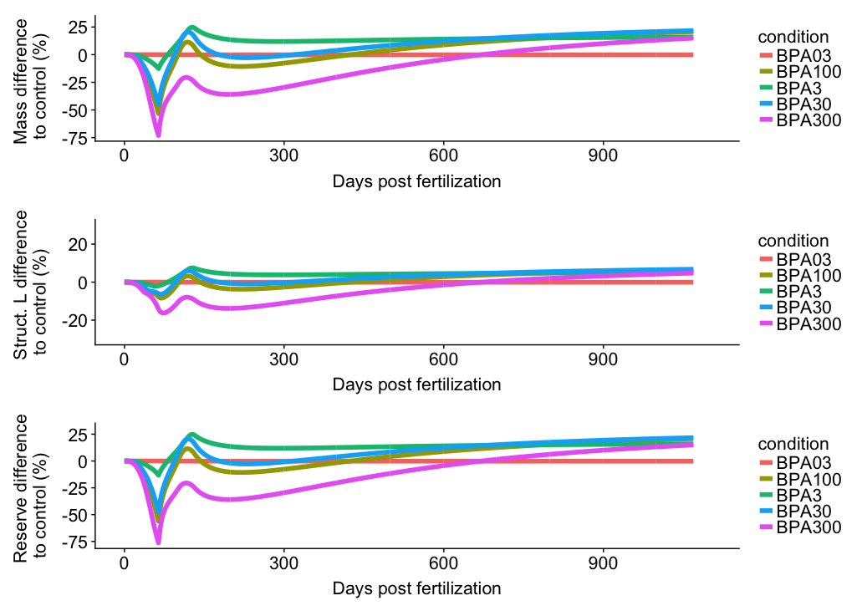
f = 1

